Slide 1

Optional/Default and named parameters

Slide 2
Using Optional Parameters
Optional parameter
One for which a default value is automatically supplied
Make a parameter optional by providing a value for it in the method declaration
Any optional parameters in a parameter list must follow all mandatory parameters (i.e. Optional parameters at the end of the list!)

Slide 3
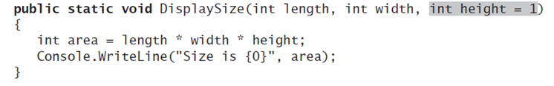
Example

Slide 4
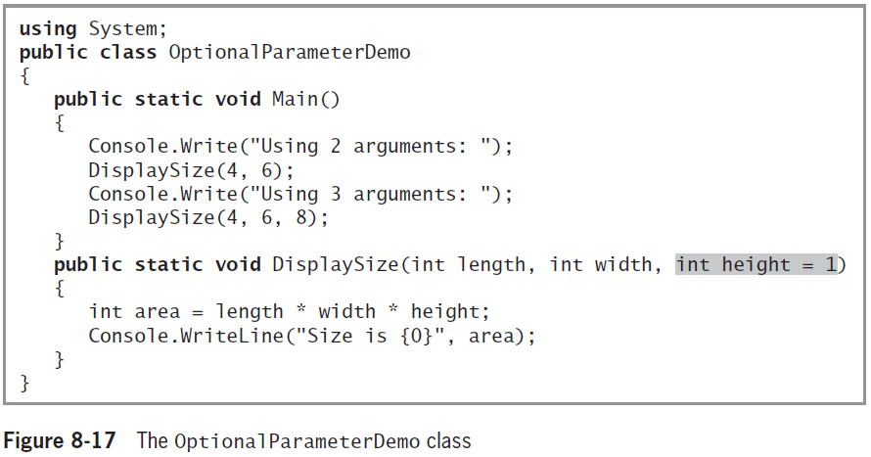
Leaving Out Unnamed Arguments
When calling a method with optional parameters (and you are using unnamed arguments)
Leave out any arguments to the right of the last one you use

Slide 5
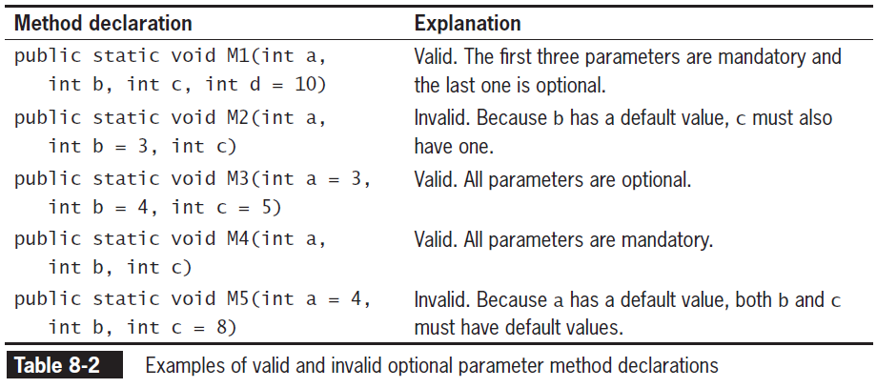
Using Optional Parameters (cont'd.)

Slide 6
Using Optional Parameters (cont'd.)

Slide 7
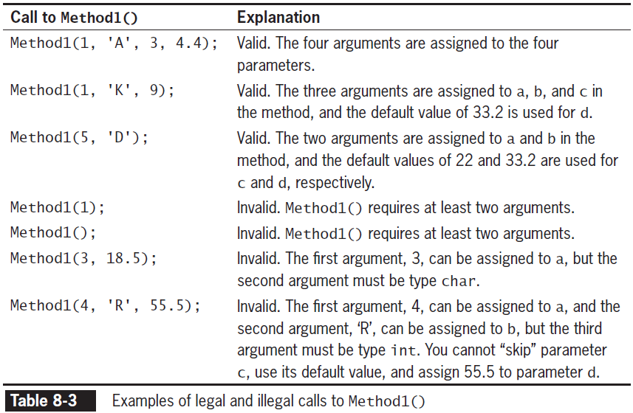
Leaving Out Unnamed Arguments (cont'd.)

Slide 8
Leaving Out Unnamed Arguments (cont'd.)

Slide 9
Using Named Arguments
Since C# 4.0, leave out optional arguments in a method call
If you pass the remaining arguments by name
Named arguments appear in any order
But must appear after all the unnamed arguments have been listed
Name an argument using its parameter name and a colon ‘:’ before the value

Slide 10
Example
static void Main(string[] args)
{
// The method can be called in the normal way, by using positional arguments.
PrintOrderDetails("Gift Shop", 31, "Red Mug");
// Named arguments can be supplied for the parameters in any order.
PrintOrderDetails(orderNum: 31, productName: "Red Mug", sellerName: "Gift Shop");
PrintOrderDetails(productName: "Red Mug", sellerName: "Gift Shop", orderNum: 31);
// Named arguments mixed with positional arguments are valid
// as long as they are used in their correct position.
PrintOrderDetails("Gift Shop", 31, productName: "Red Mug");
PrintOrderDetails(sellerName: "Gift Shop", 31, productName: "Red Mug"); // C# 7.2 onwards
PrintOrderDetails("Gift Shop", orderNum: 31, "Red Mug"); // C# 7.2 onwards
// However, mixed arguments are invalid if used out-of-order.
// The following statements will cause a compiler error.
// PrintOrderDetails(productName: "Red Mug", 31, "Gift Shop");
// PrintOrderDetails(31, sellerName: "Gift Shop", "Red Mug");
// PrintOrderDetails(31, "Red Mug", sellerName: "Gift Shop");
}
static void PrintOrderDetails(string sellerName, int orderNum, string productName)
{
Console.WriteLine($"Seller: {sellerName}, Order #: {orderNum}, Product: {productName}");
}
https://docs.microsoft.com/en-us/dotnet/csharp/programming-guide/classes-and-structs/named-and-optional-arguments

Slide 11
Overload Resolution with Named and Optional Arguments
Named and optional arguments affect overload resolution
Rules for betterness on argument conversions are applied only for arguments that are given explicitly
If two signatures are equally good
Signature that does not omit optional parameters is considered better

Slide 12
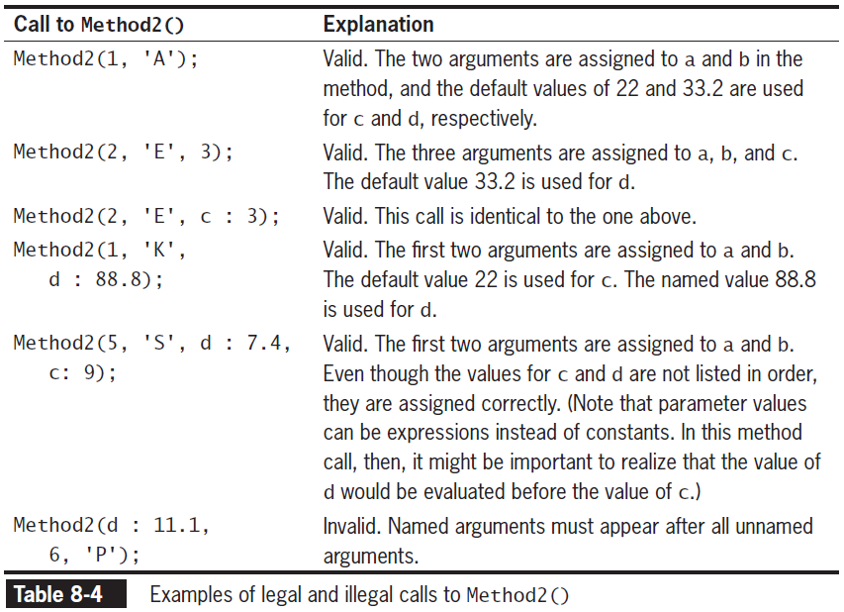
Using Named Arguments (cont'd.)

Slide 13
Using Named Arguments (cont'd.)

